Slide 1
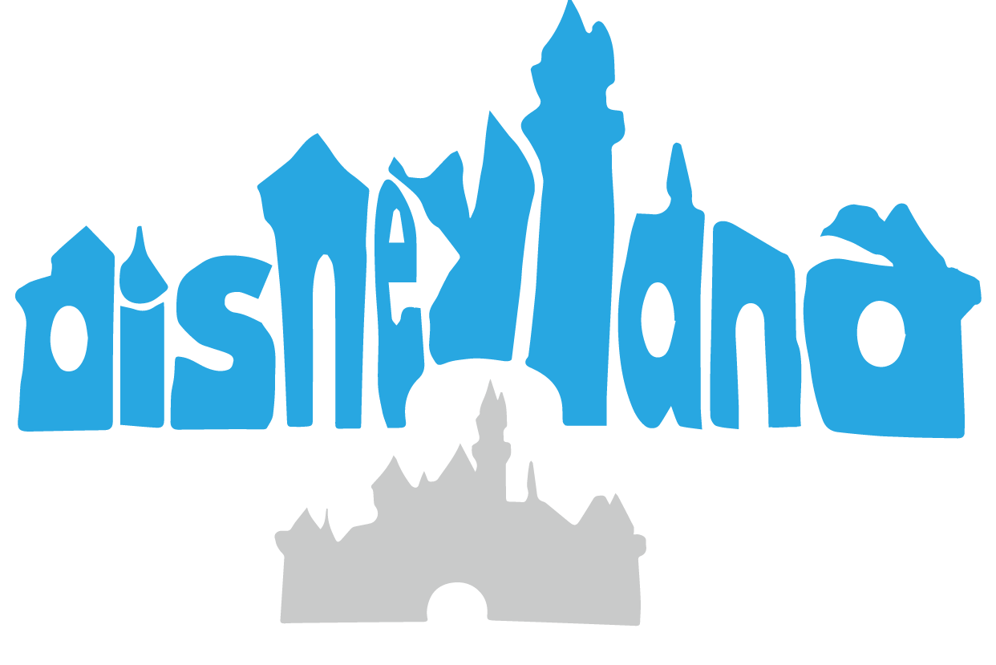
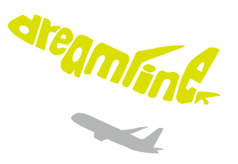
Legible Compact Calligrams
Changqing Zou^{1,2} Junjie Cao³ Warunika Ranaweera¹ Ibraheem Alhashim¹
Ping Tan¹ Alla Sheffer⁴ Hao Zhang¹
¹Simon Fraser University
²Hengyang Normal University
³Dalian University of Technology
⁴University of
British Columbia
Notes:
Thanks for the introduction. Good afternoon everyone, I am Changqing ZOU, a postdoc from Simon Fraser University. In this talk, I will present our work on compact calligram generation.

Slide 2
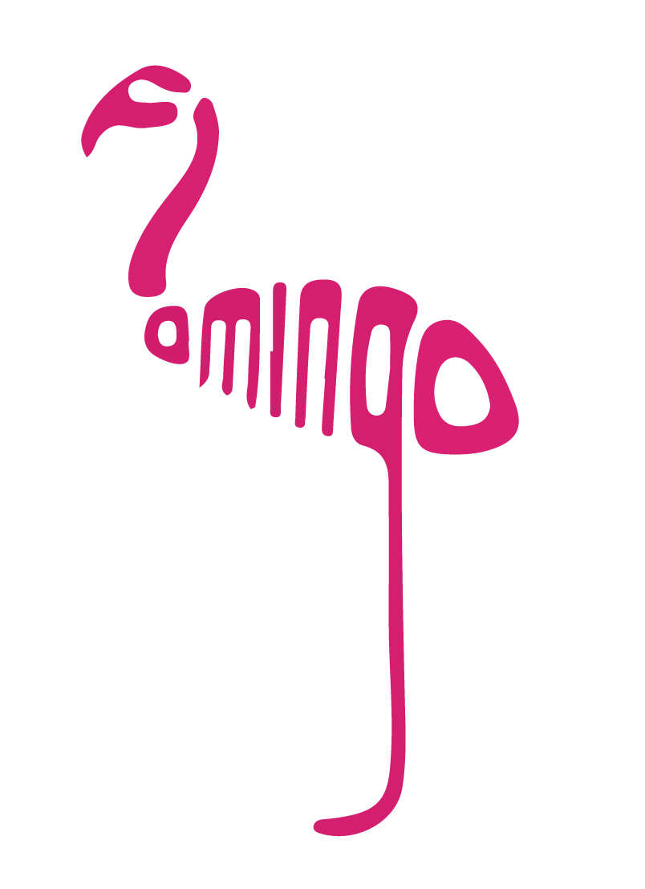
Legible Compact Calligram
flamingo
Notes:
A compact calligram is a visual image composed of letters, which elegantly conveys two things: a shape and one or few words.

Slide 3
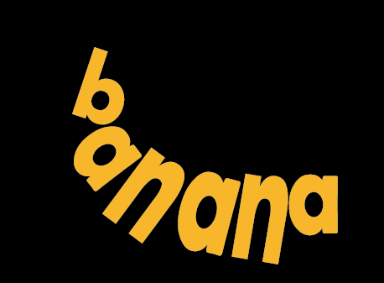
Legible Compact Calligram
Legible: readable
Change to Snail or another example
Notes:
In a compact calligram, letters must be deformed, often significantly, to fit the shape, but we still want the letters and words to be legible or readable.

Slide 4
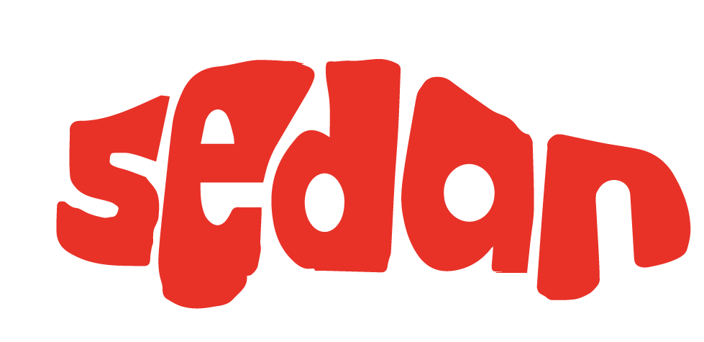
Legible Compact Calligram
sedan
Notes:
For example, for this input shape, we have two calligrams. Which one do you think is more readable? The left one or the right one? Yes, From the right one, we can recognize the word sedan more easily. So, we can see the legibility of a calligram does make a difference.

Slide 5
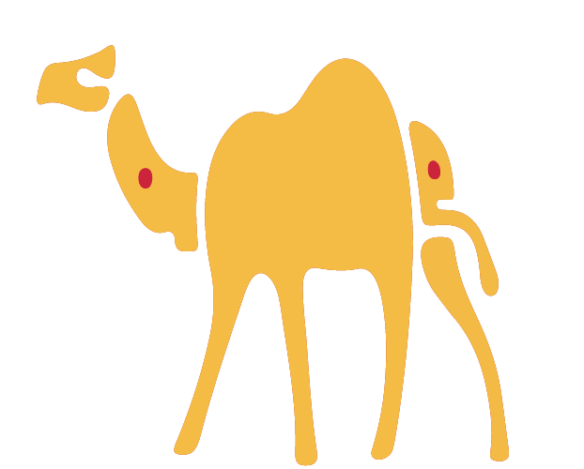
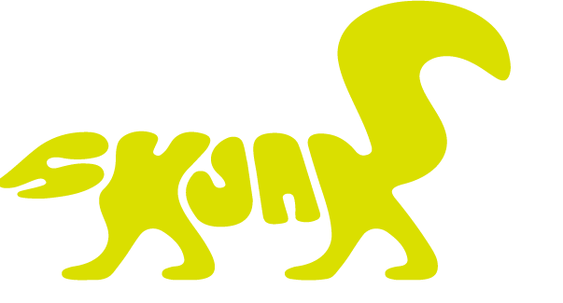
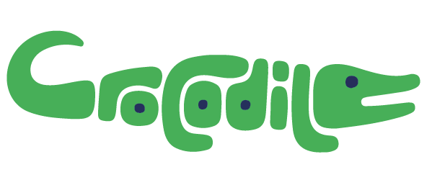
Artist creations
Calligrams created by professional artists
Notes:
Nicely designed calligrams are really cool. Our work was initially motivated by the beautiful word animals created by the artist Dan Fleming. There are calligrams in many languages! For example, this Chinese Callligram which conveys a Chinese words: beautiful girl. Creating elegant calligram usually require a significant level of human creativity and artistry, and the process is very time-consuming.

Slide 6
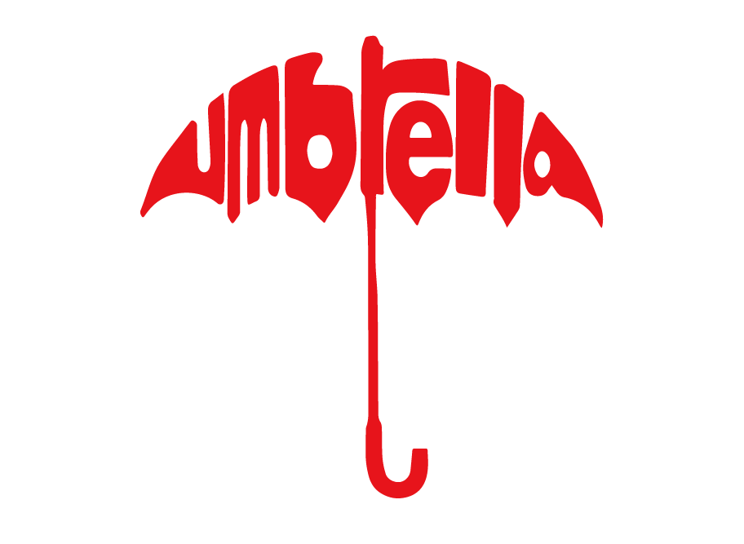
Fully automatic calligram generation?
automatically
umbrella
Notes:
Thus, it comes out our research problem: given a word and a shape, is it possible to automatically generate compact calligrams, which are comparable to the artist creations? This problem contains several major requirements.

Slide 7
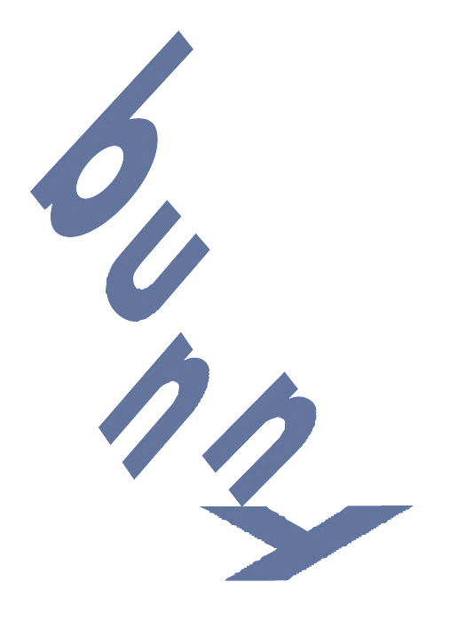
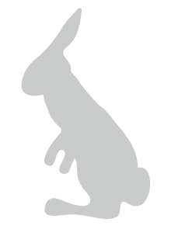
Requirement #1: Letters convey the shape
Boundary conformation + filling the interior
Notes:
First, the letters must convey the input shape, both along the boundary and inside the interior. To achieve this, the letters must be deformed.

Slide 8
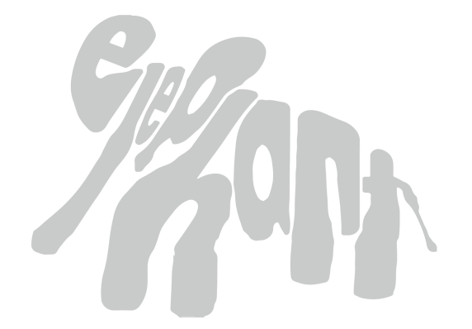
Requirement #2: Legibility
Use a more legibile example
elephant
Legibility of individual letters AND the word(s)
Notes:
More importantly, as the letters are deformed, we must ensure legibility at both the levels of letters and words.
Meeting those requirements at the same time mainly involves three challenges.

Slide 9
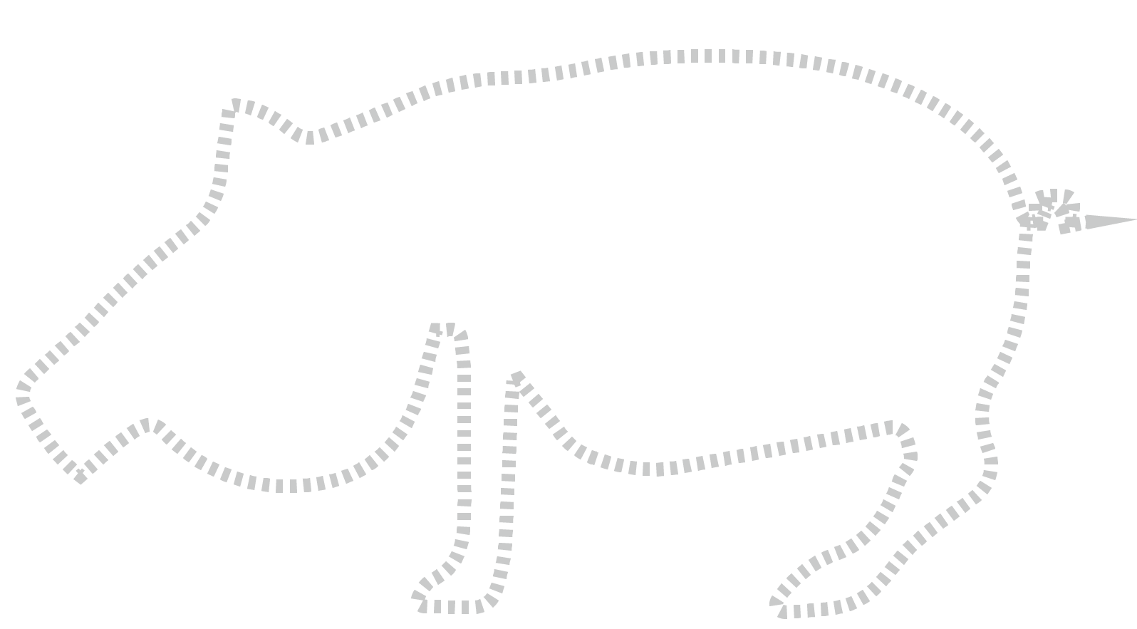
Challenges
Challenge 1: Automatic co-placement of a set of letters
Notes:
The first challenge is to co-place a set of letters automatically. This challenge requires the system to solve correspondence and layout problems, rather than
user interaction.

Slide 10
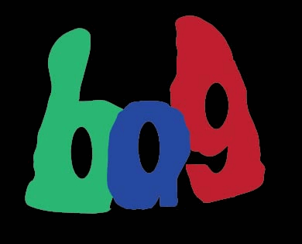
Challenges
Challenge 2: Co-deformation of a set of letters
Notes:
The second and the key challenge is letter deformation. Unlike classic shape deformation which only involves an individual entity, in our problem, a SET of letters are co-deformed and their deformations constrain with each other.

Slide 11
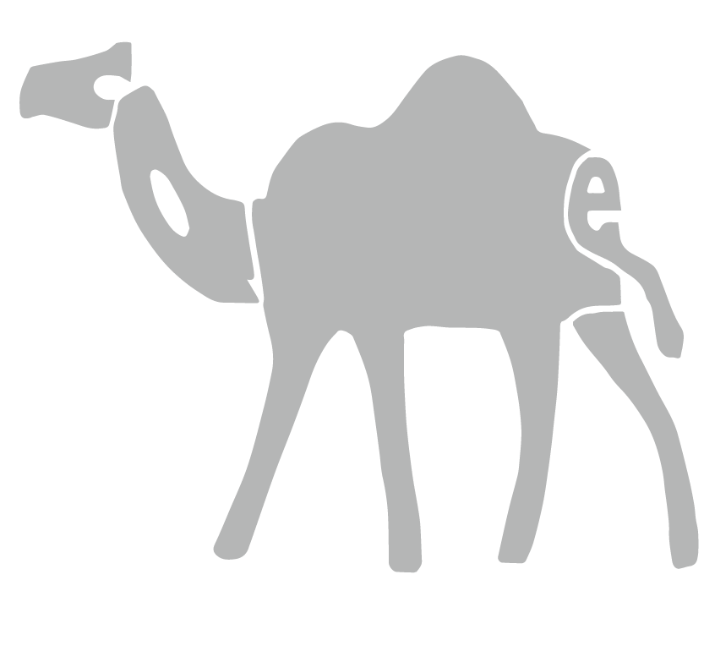
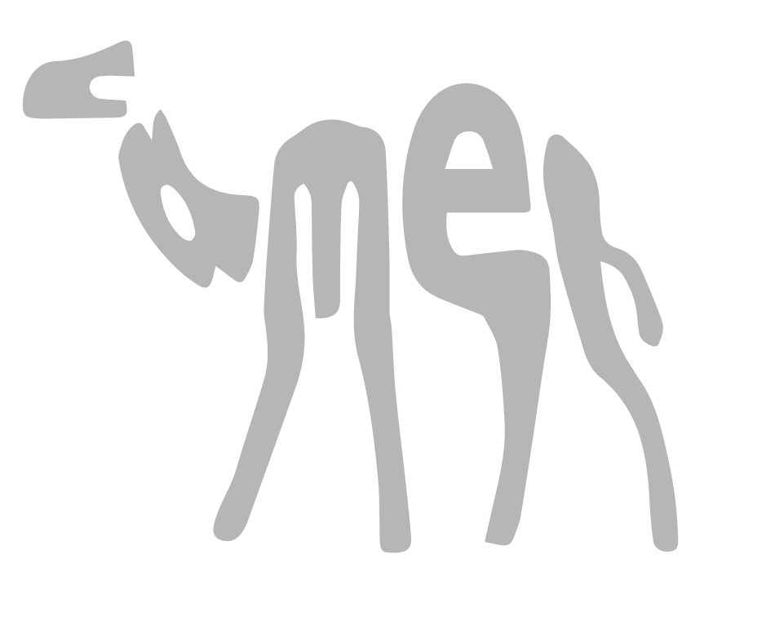
Challenges
0.60
0.95
>
< ?
=
Calligram1
Calligram2
Legibility measure for deformed letters
Legibility measure for deformed word(s)
Challenge 3: Legibility measure is a new problem
Notes:
More importantly, the deformation must ensure legibility, based on a well-developed legibility measure. Unfortunately, no previous research has addressed the problem of legibility measurement.
Ok. Let us see how we handle these challenges.

Slide 12
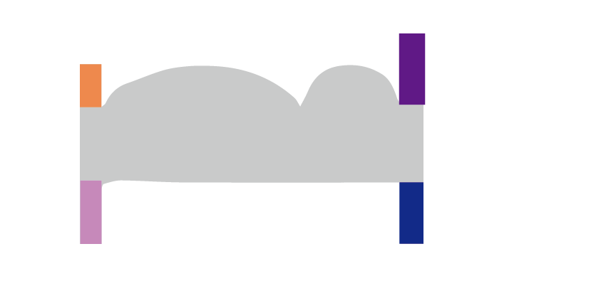
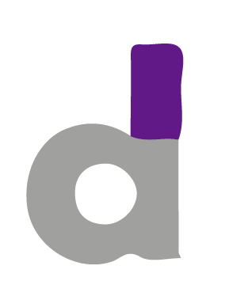
Key Insight
Protrusion feature for letter CO-placement
Notes:
To solve the problem of automatic co-placement of a set of letters, we have developed a robust protrusion feature based algorithm. Our algorithm is based on an observation: we found there are protrusions in both of letters and shapes. Those protrusions characterize both shapes and letters. And theycan be used to effectively handle the co-placement problem.

Slide 13
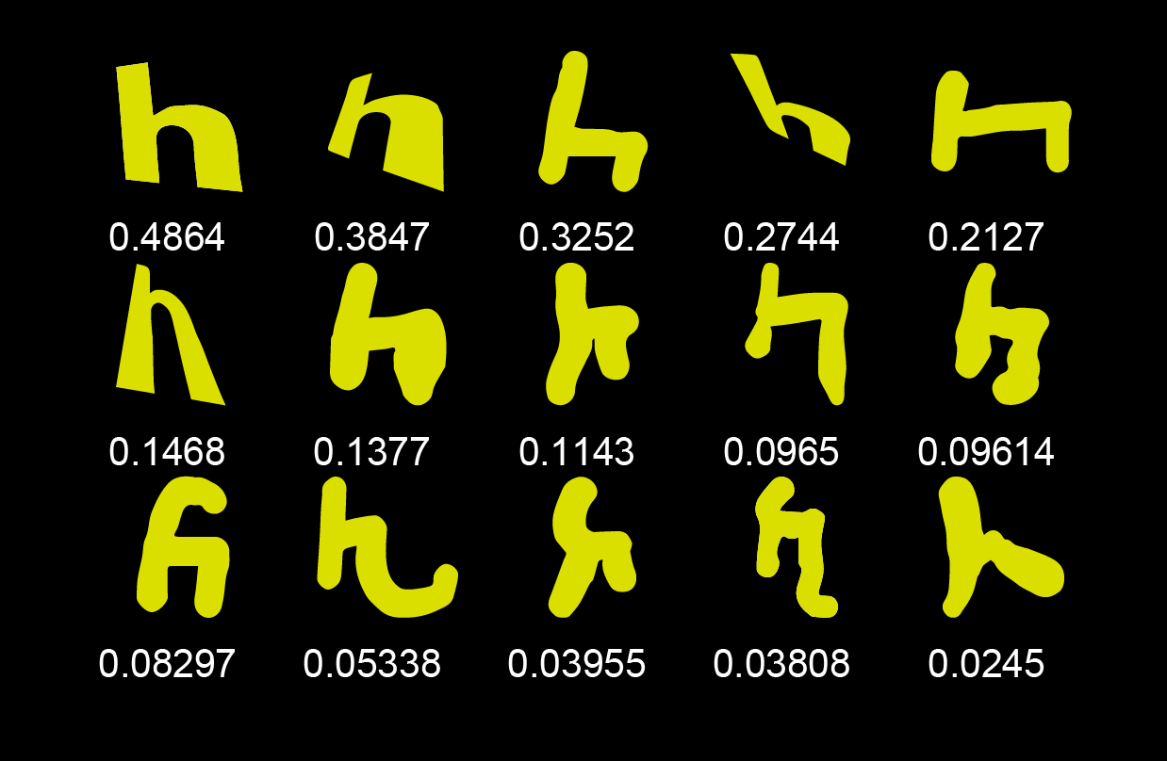
Key technique
A reliable legibility measure
Notes:
To measure the legibility of deformed letters, we collected a great amount of crowd-sourcing data and learnt a reliable measure, which can give a legibility score consistent with the human perception.

Slide 14
Outline
Pipeline
Methodology detail
Results
Limitation
Notes:
Let’s see how our method goes.

Slide 15
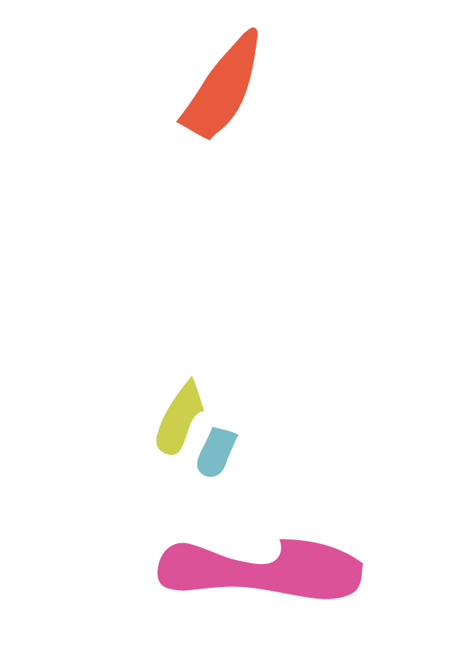
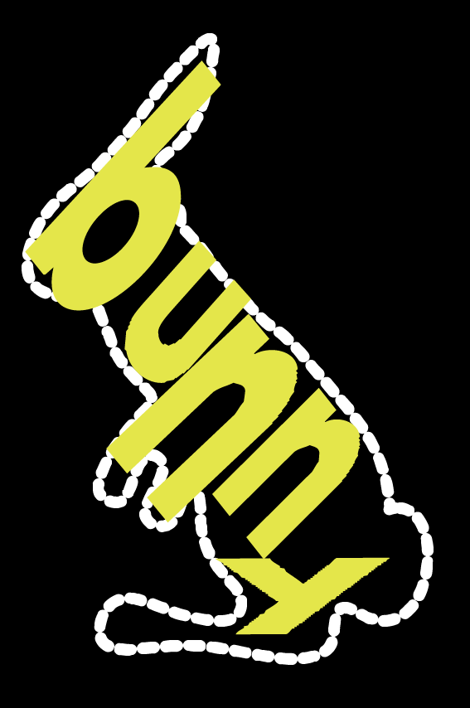
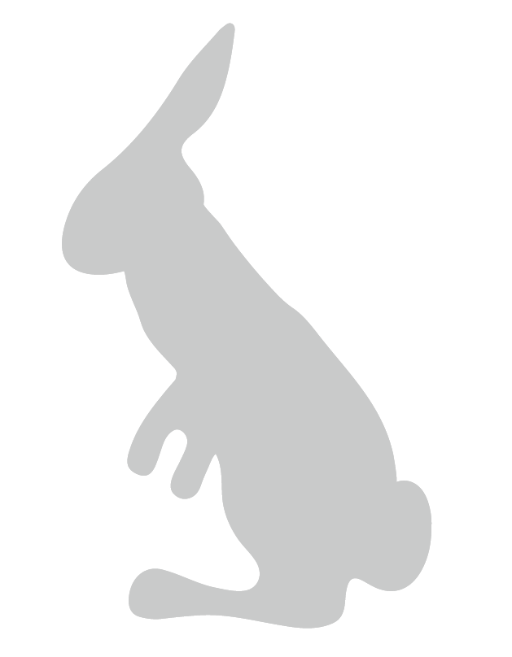
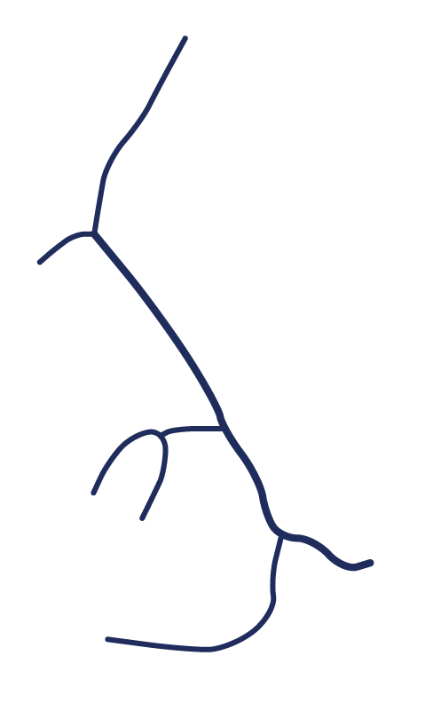
Our solution
Alignment
Deformation
Coarse-to-fine strategy based pipeline
Notes:
Our method is coarse-to-fine strategy based. It has two key steps:
a letter alignment step for aligning the input shape with letters.
And a letter deformation step for the requirements of shape fitting and legibility

Slide 16
Outline
Methodology detail
Letter alignment
Letter deformation
Legibility learning
Results
Limitation
Conclusion
Notes:
let ‘s go deeper into those two steps.

Slide 17
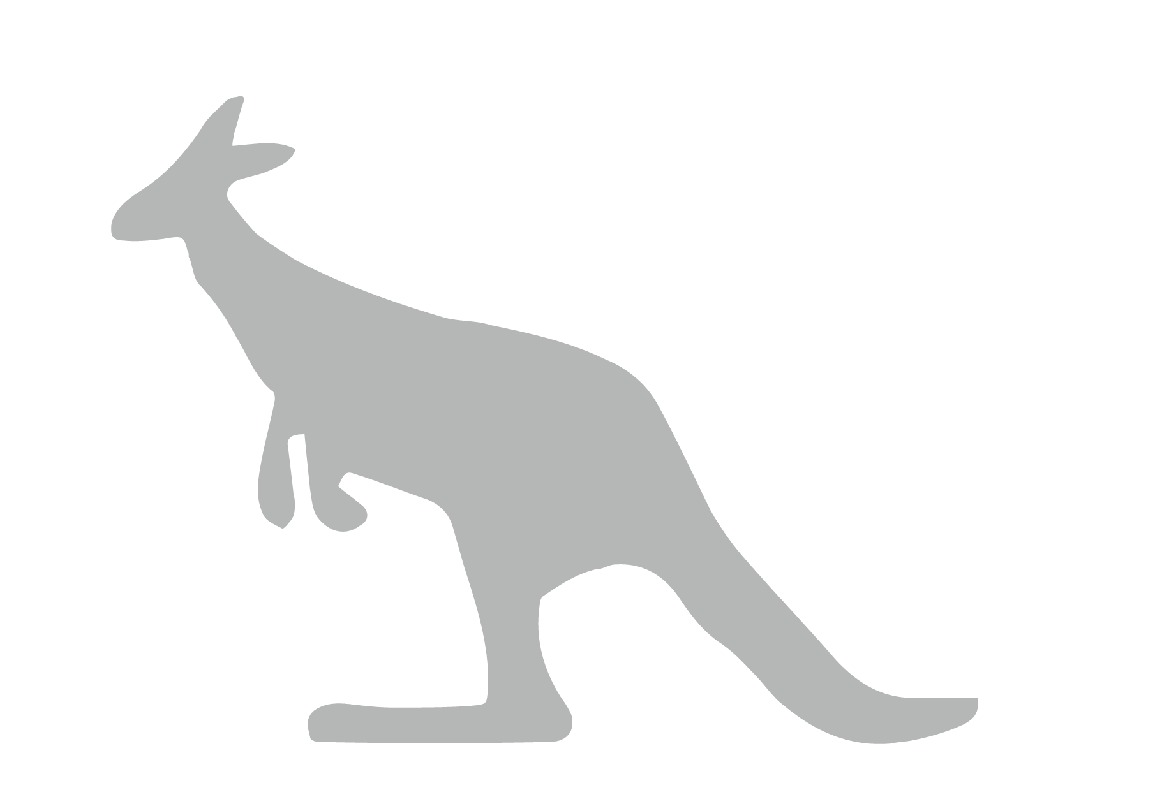
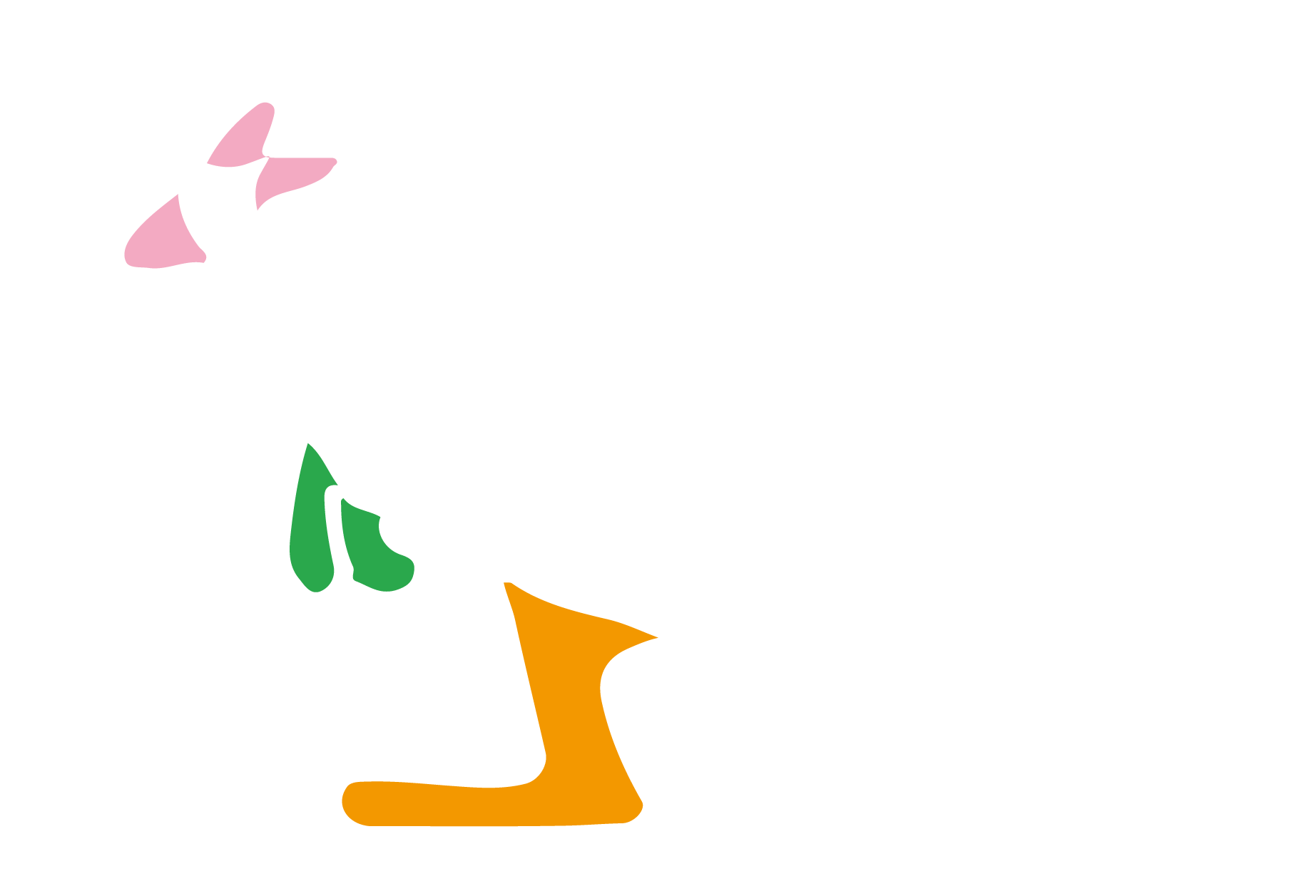
Initial letter alignment
kangaroo
Notes:
IN the letter alignment step we first detect salient protrusions of the input shape

Slide 18
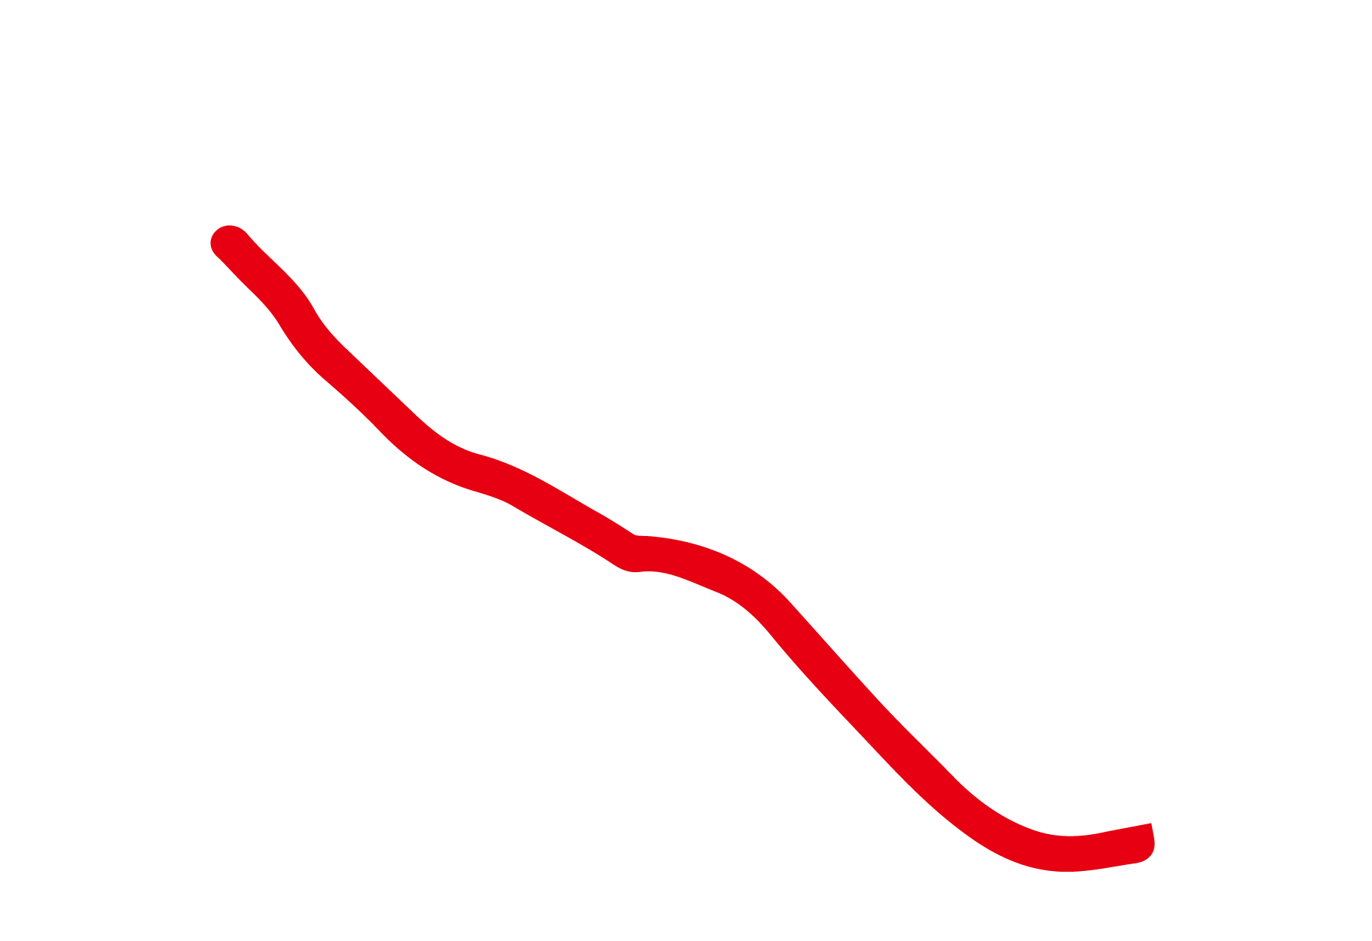
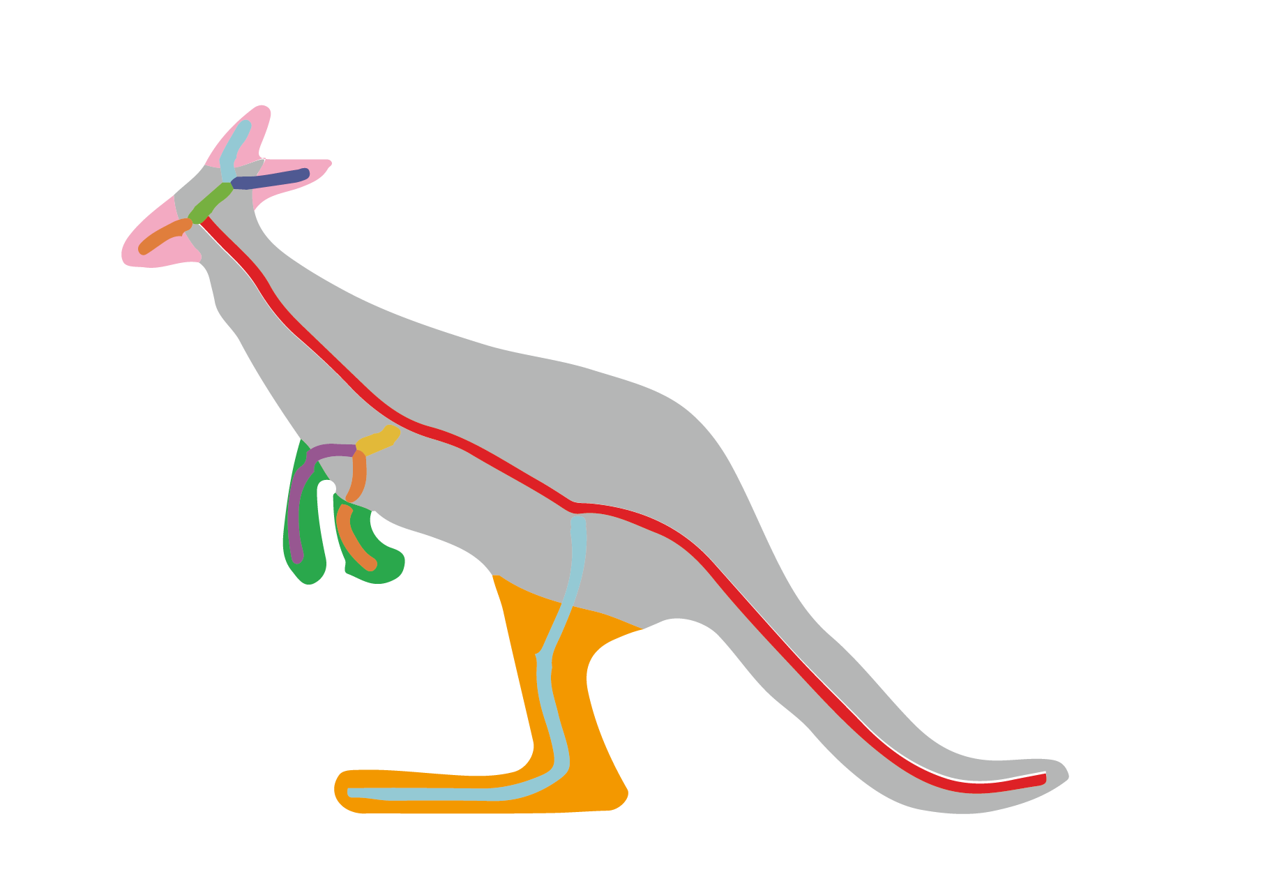
Initial letter alignment
kangaroo
Notes:
And then extract the shape skeleton, and select the longest branch as the layout path of letters.

Slide 19
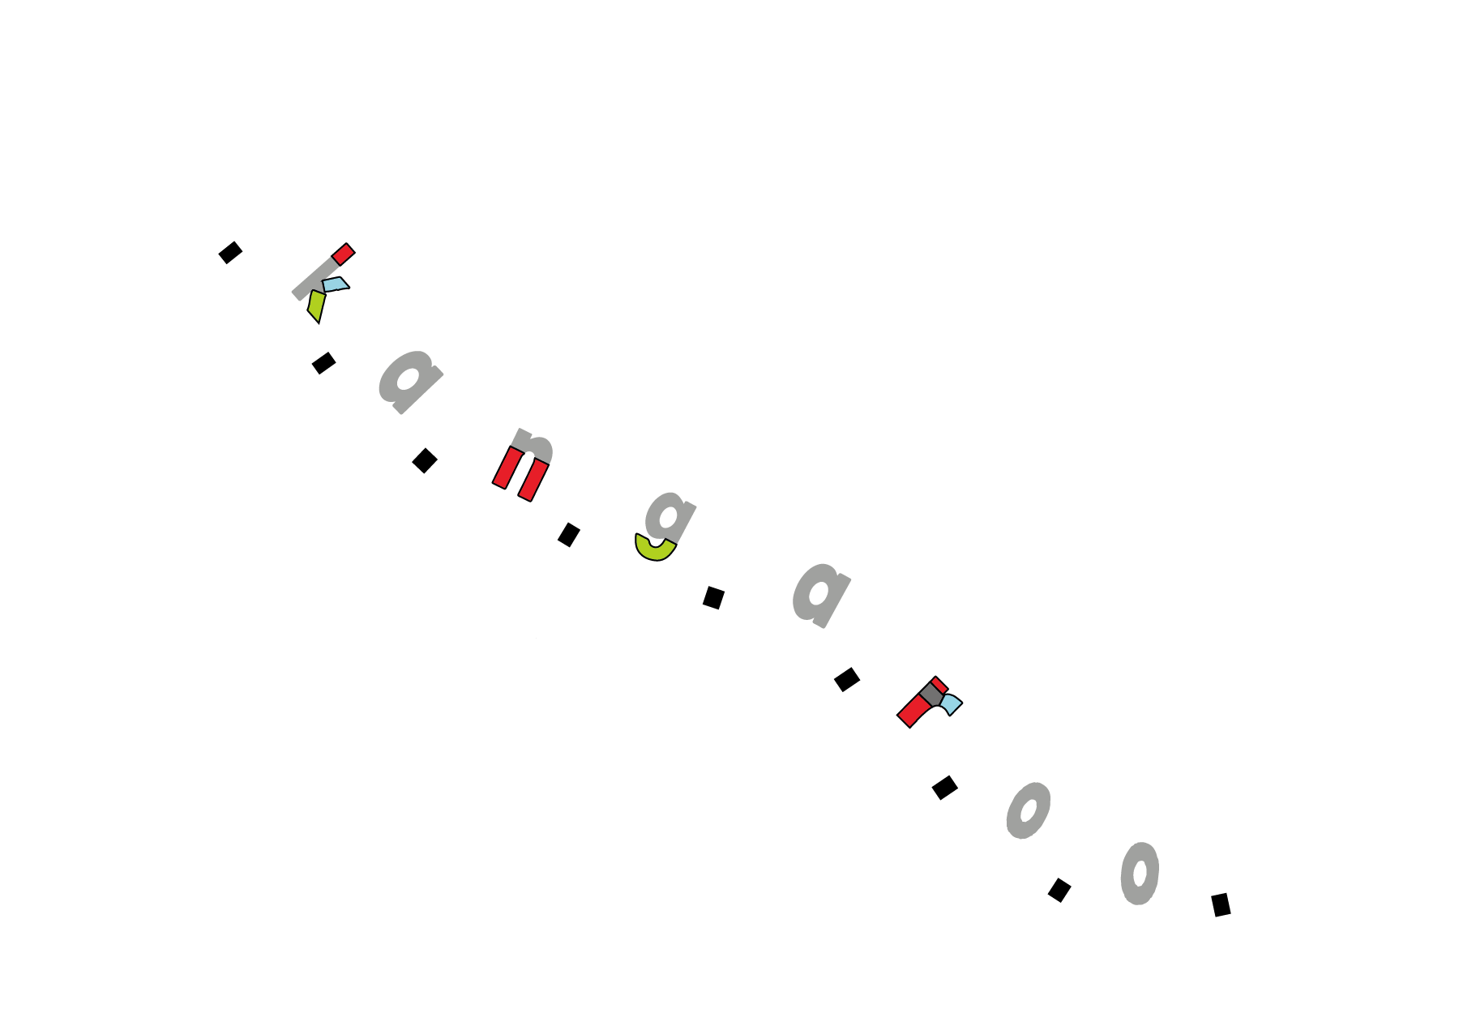
Initial letter alignment
kangaroo
Type and orientation compatibility
Location compatibility
Non- inverse letter sequence
Notes:
Next, we compute an optimal correspondence between protrusions within both letters and the outline image using three types of constraints
to obtain an initial letter alignment.

Slide 20
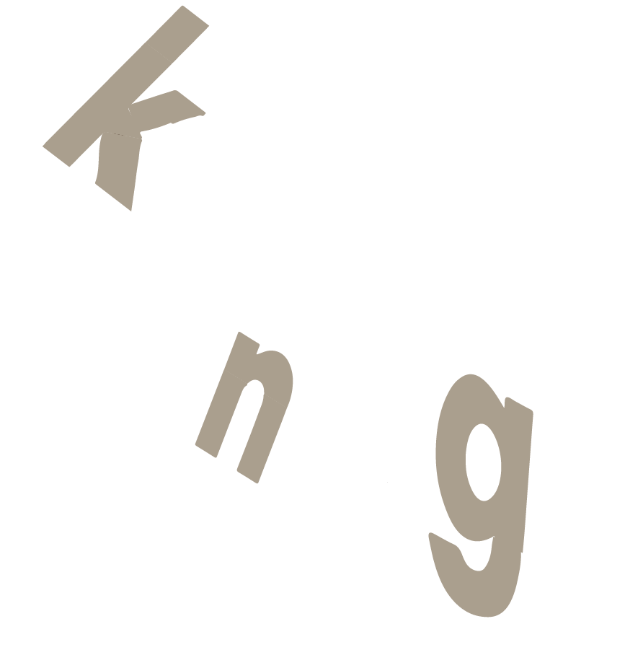
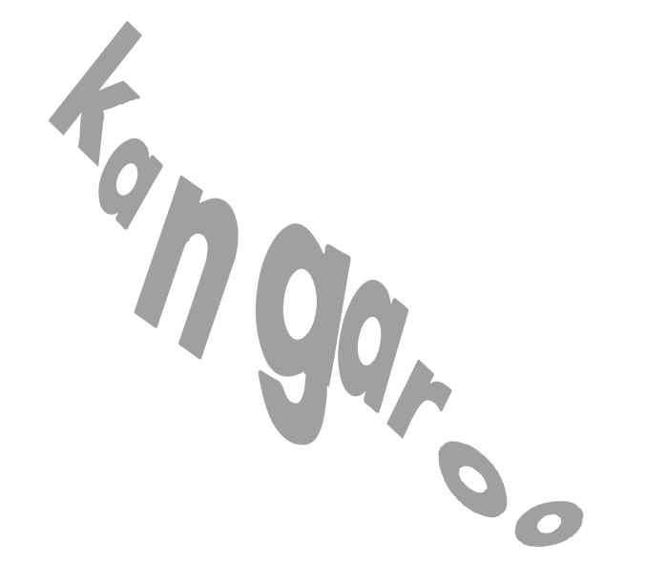
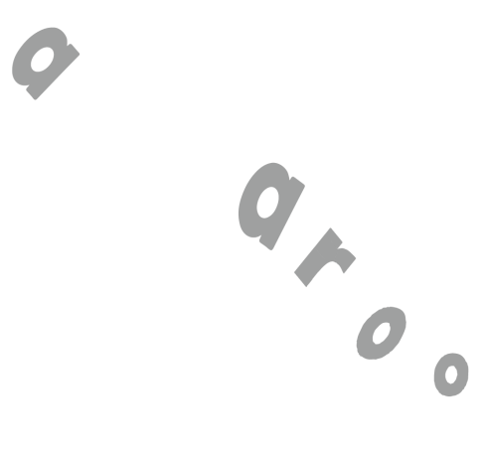
Refined alignment
Notes:
After that, we fix the initial statuses of the letters which have the corresponding protrusions of letters. And insert the remaining letters in-between them.
To produce a good starting point for letter deformation, we further refine the letter alignment by adjusting the position, size, orientation, and aspect rations of each individual letter.

Slide 21
Objective function for refining alignment
Letter legibility
Shape conformation
simplify
Word legibility
Letter legibility: how legible a letter with aspect ratio changed is
Shape conformation: how closely the outer hull and interior coverage of the letters fit the input shape
Inter-letter legibility: how similar the statues of all the letters are
Letter legibility: how legible a letter with aspect ratio changed is
Shape conformation: how closely the outer hull and interior coverage of the letters fit the input shape
Word legibility: how similar the statues of all the letters are
Notes:
We formulate the refined letter alignment as an optimization problem with such an objective function.
It contains three terms. The first term is for letter legibility. It is used to evaluate the legibility of the letters which have the changes of aspect ratio;
The second term is for shape conformation. It evaluate how closely the outer hull and interior coverage of the letters fit the input shape;
The last term is for word-legibility, which gives a score for the statue consistence of all the individual letter;

Slide 22
Outline
Pipeline
Methodology detail
Letter alignment
Letter deformation
Legibility learning
Results
Limitation
Notes:
In the letter deformation step,

Slide 23
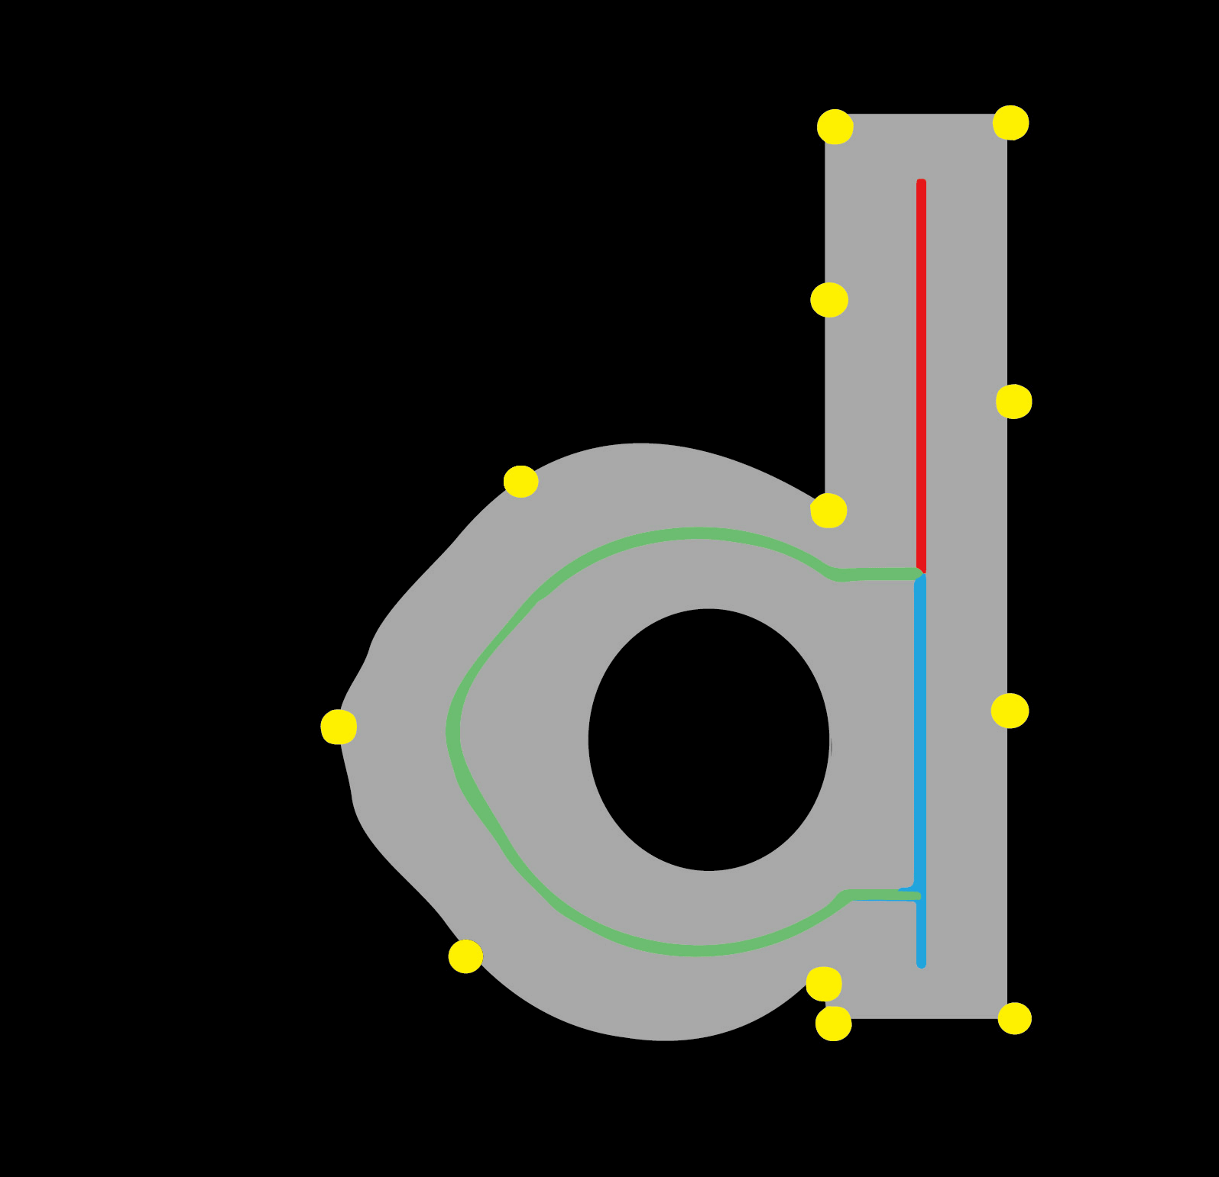
Legibility-driven deformation
Letter deformation based on the movements of control points
Notes:
The deformation of each individual letter is based on the movement of the control points on the letter boundary. The deformation is driven by a similar objective function as the refined letter alignment step, but with the letter legibility term updated by a more sophisticated measurement .

Slide 24
Outline
Methodology detail
Letter alignment
Letter deformation
Legibility learning [Liang et. al 2014]
Results
Limitation
Conclusion
Notes:
To learn the legibility score of deformed letters

Slide 25
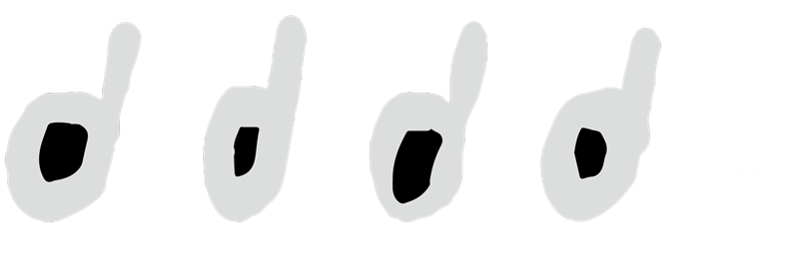
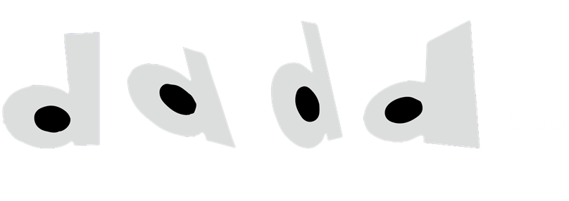
Steps of legibility score learning
Training Data: 30,000+ deformed shapes for 26 lowercase Latin letters
80%
1500+ samples
Thickening user-drawn skeletons
20%
Wrapping
Notes:
We collected more than 30,000 deformed shapes for all the 26 lowercase Latin letters.
We generate the deformed shapes for training data in two ways. The first one is thickening the strokes of user-drawn letters, which contributes 80% samples;
the other one is wrapping the standard letters, which contribute 20% samples of training data.
For each individual letter, we collected about 1500 samples. For legibility learning, we collected
more than 200 pairs pair-wise legibility comparison data for each letter by the Amazon Mechanical Turk service

Slide 26
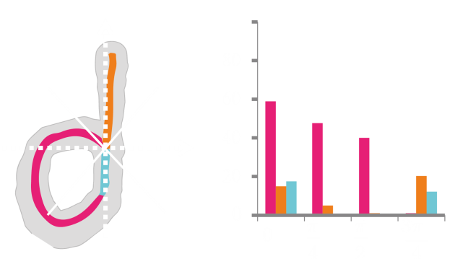
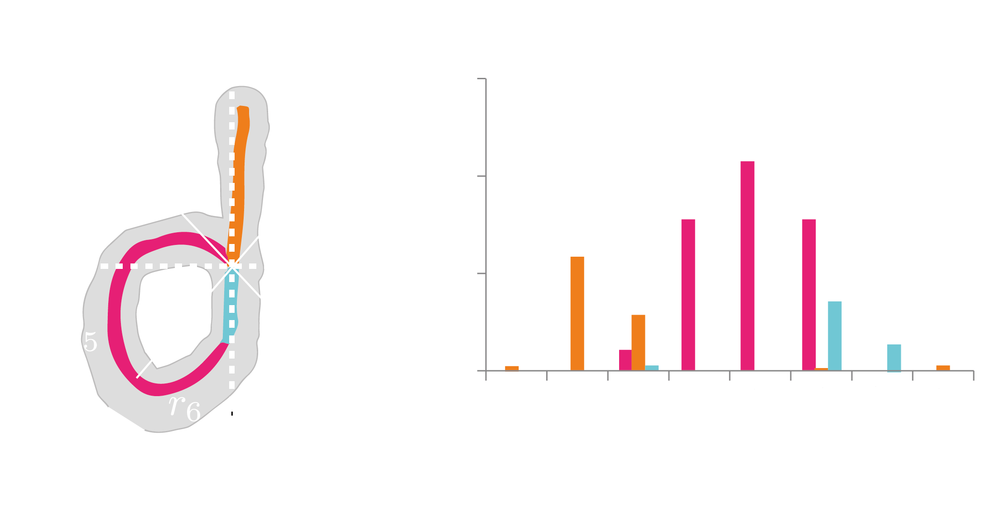
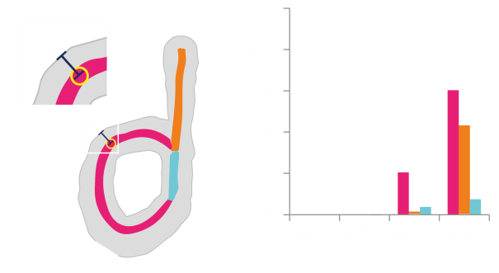
Legibility feature
Step1: Separate each letter into its strokes
Step2: Represent each stroke by its skeleton and thickness profile
Step3: Concatenate the features from all strokes
P
θ
P
Directions of skeleton points
Locations of skeleton points
Thickness of strokes
Notes:
To represent deformed letters for the legibility learning, we use a skeleton-plus-thickness-profile representation. We first separate each letter into its strokes, and then define a feature vector which encodes the skeleton and thickness information of each stroke. Finally, we integrate the feature vectors from all strokes to represent the whole deformed letter.
[The relative length, represented by a scalar.
The orientation histogram of skeleton points, represented by a 4D vector.
The position histogram of skeleton points, represented by an 8D vector.
The relative thickness histogram of of skeleton points, represented by a 4D vector.
]

Slide 27
Legibility measure learning
Most open
Least open
Most smiling
Least open
Most formal
Least formal
Relative attribute ranking, [LIANG et al. 2014]
Notes:
The final legibility score for each letter is learnt by a relative attribute ranking method.

Slide 28
Outline
Pipeline
Methodology detail
Results
Limitation
Conclusion
Notes:
Now let us show some results including visual images, comparisons, and user study outcomes.

Slide 29
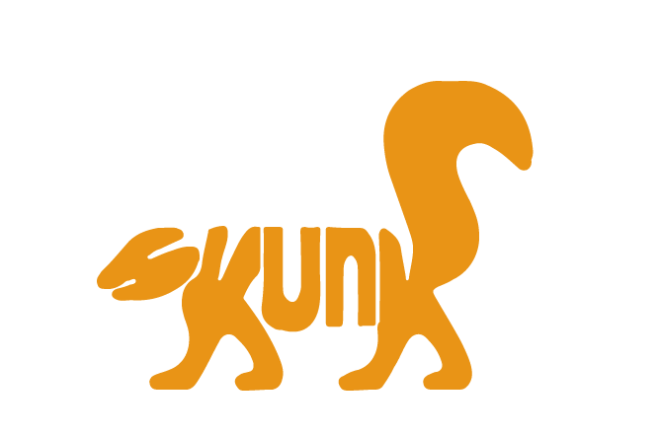
Results: animal
skunk
Notes:
Here are some results produced from animal images, skunk

Slide 30
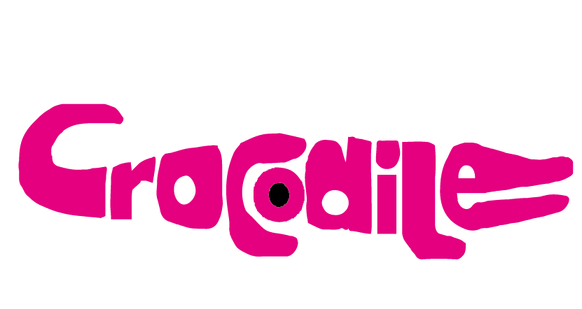
Results: animal
crocodile
Notes:
crocodile

Slide 31
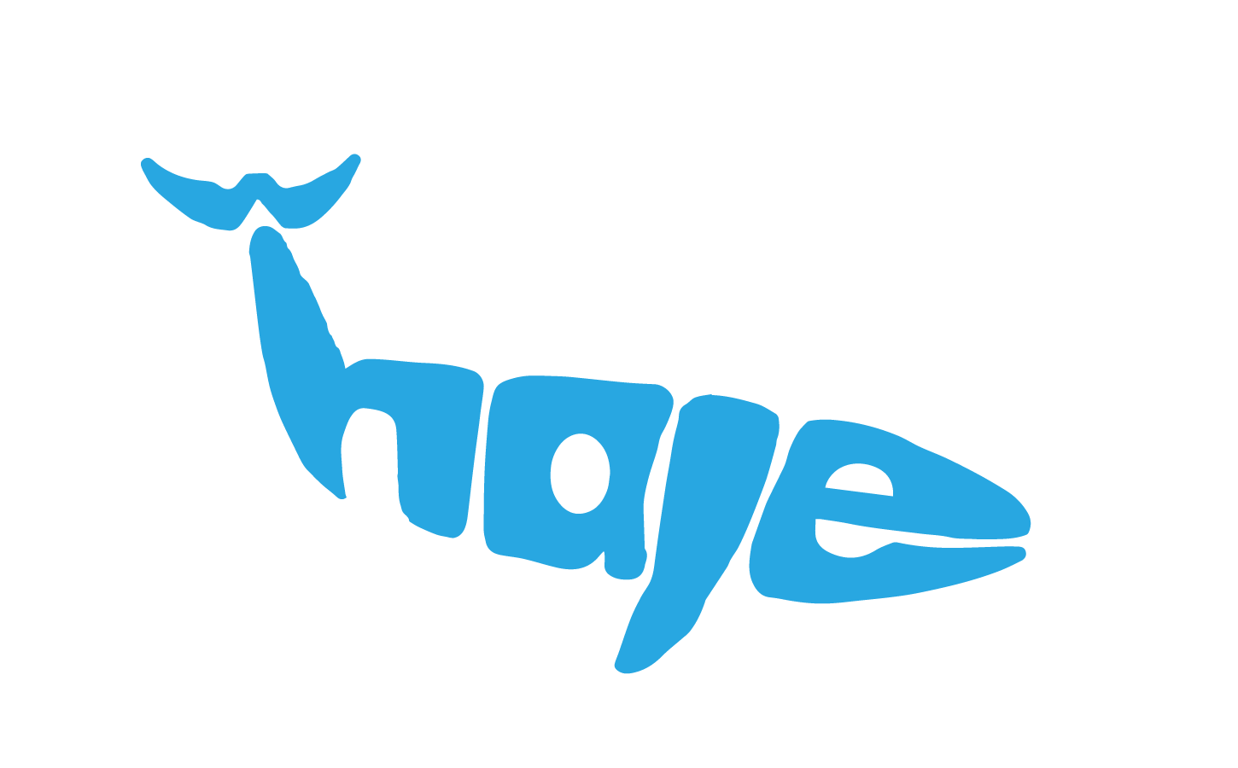
Results: animal
whale
Notes:
whale

Slide 32
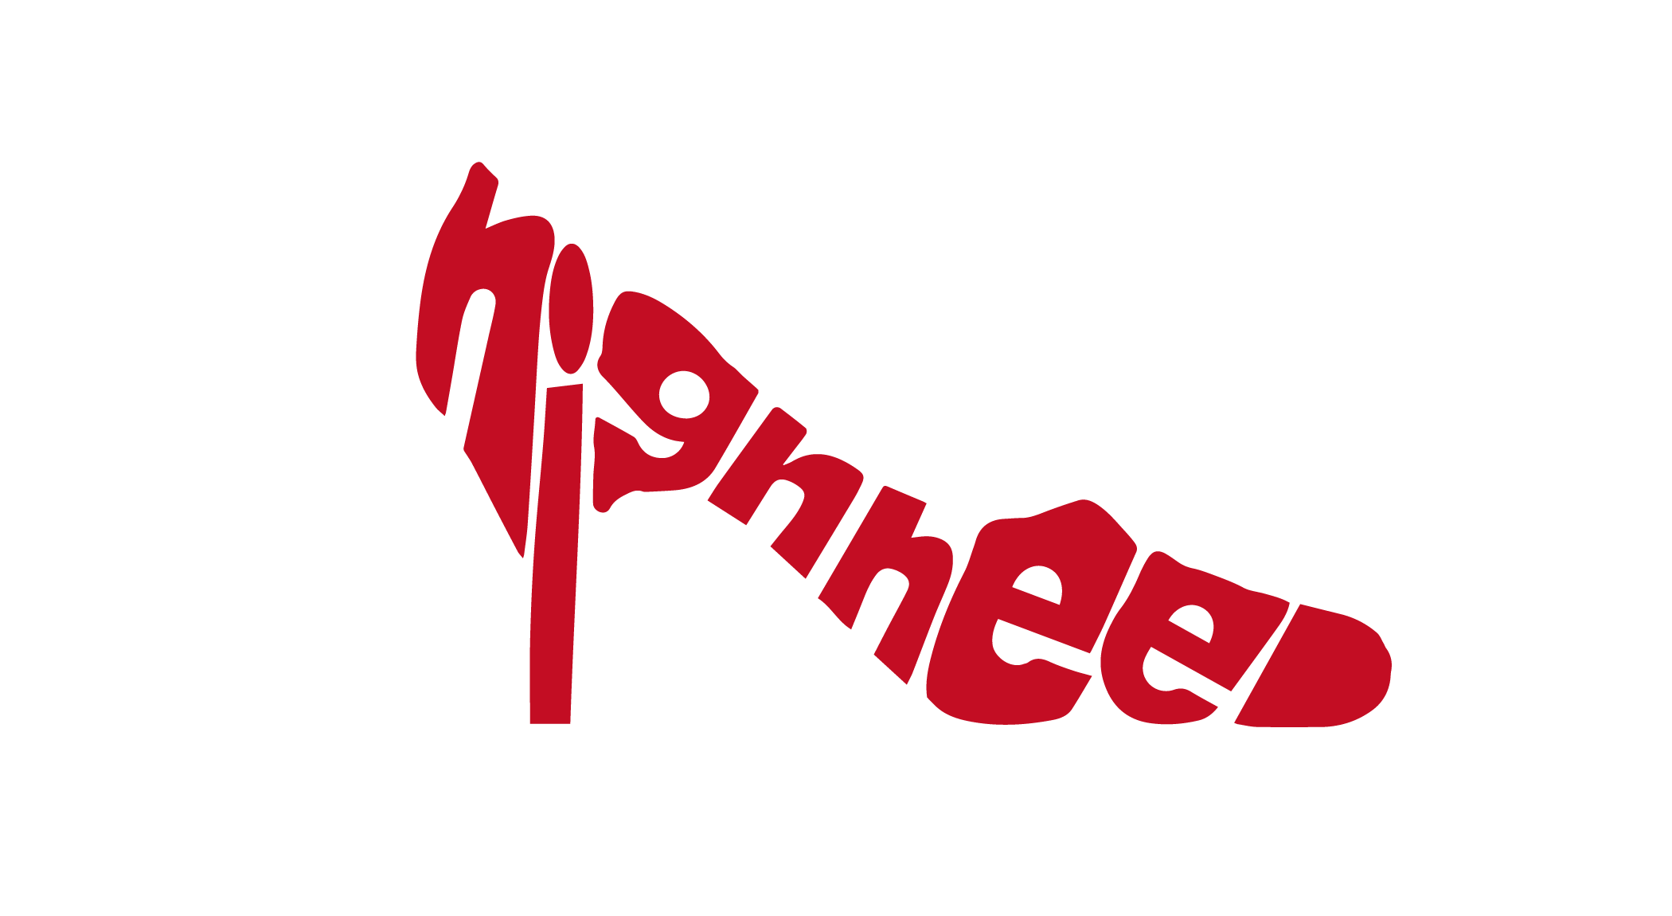
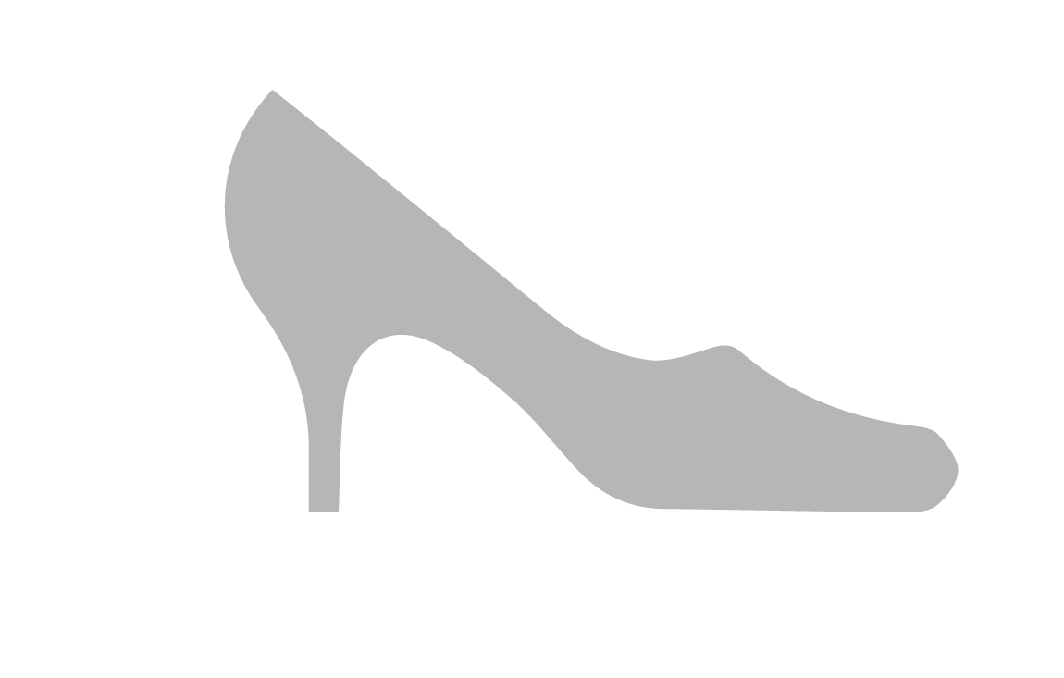
Results: wild images
highheel
Notes:
Here are some results produced for images from the wild via google image search.
Highheel.

Slide 33
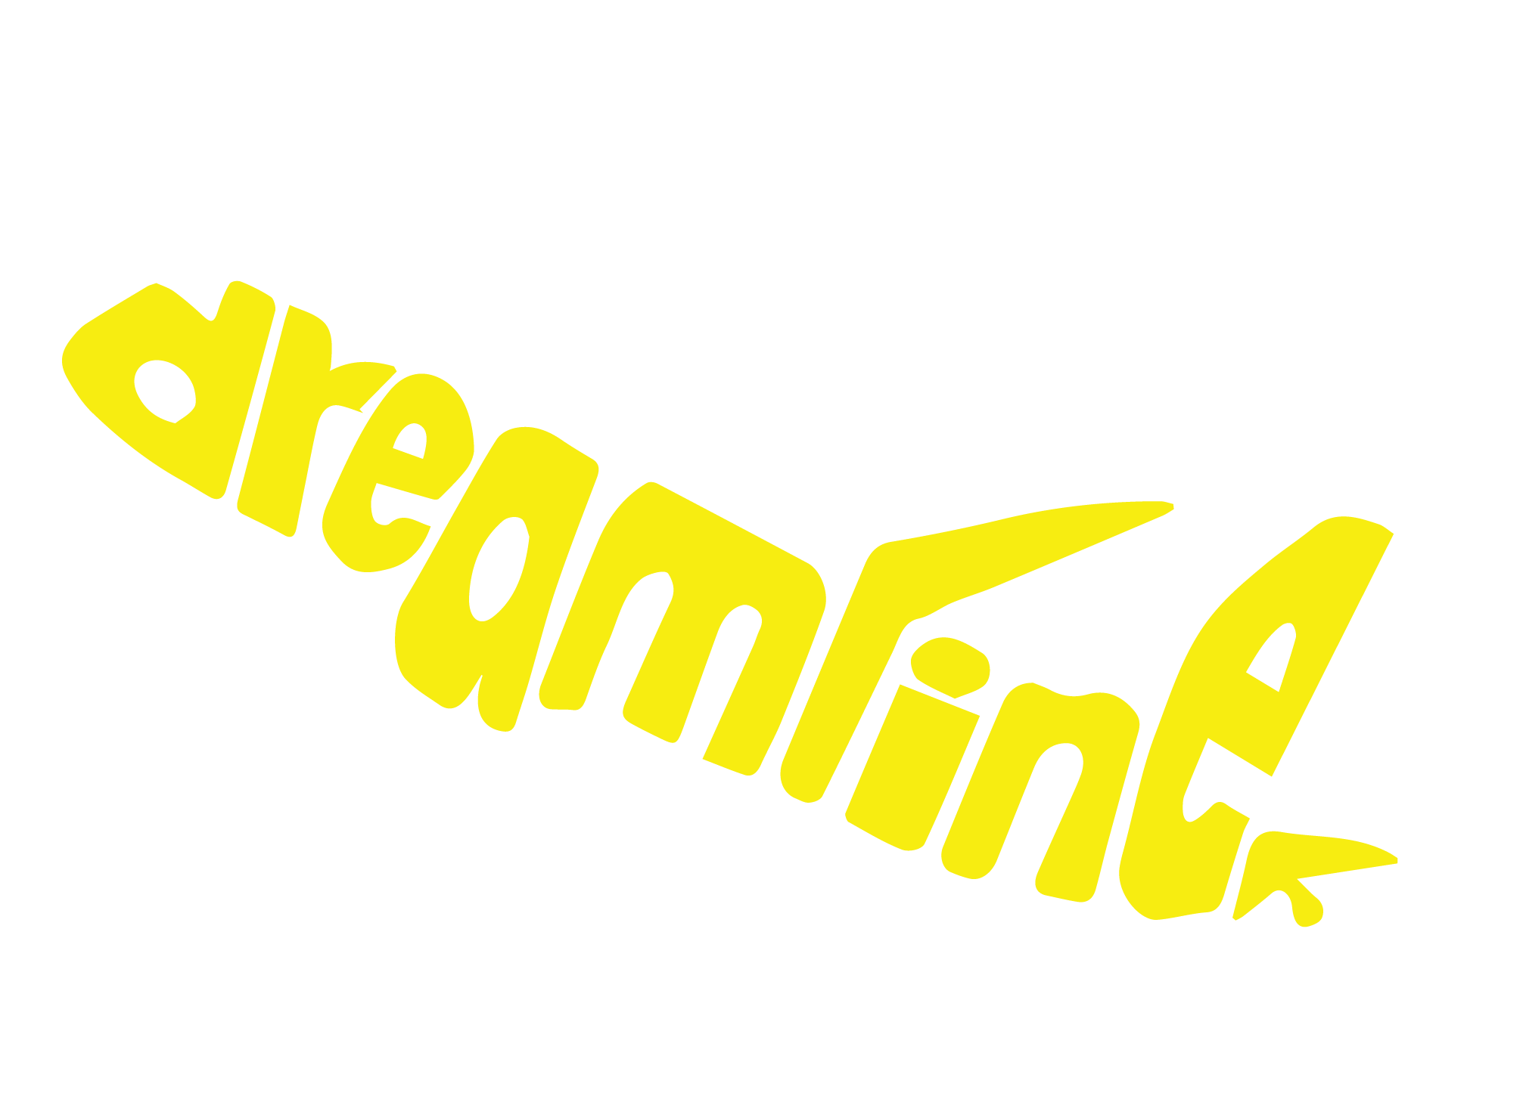
Results: wild images
dreamliner
Notes:
Dreamliner

Slide 34
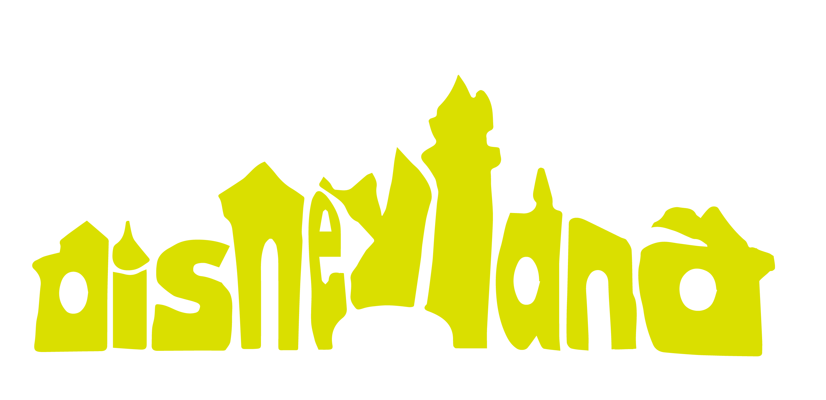
Results: wild images
disneyland
Notes:
Disneyland

Slide 35
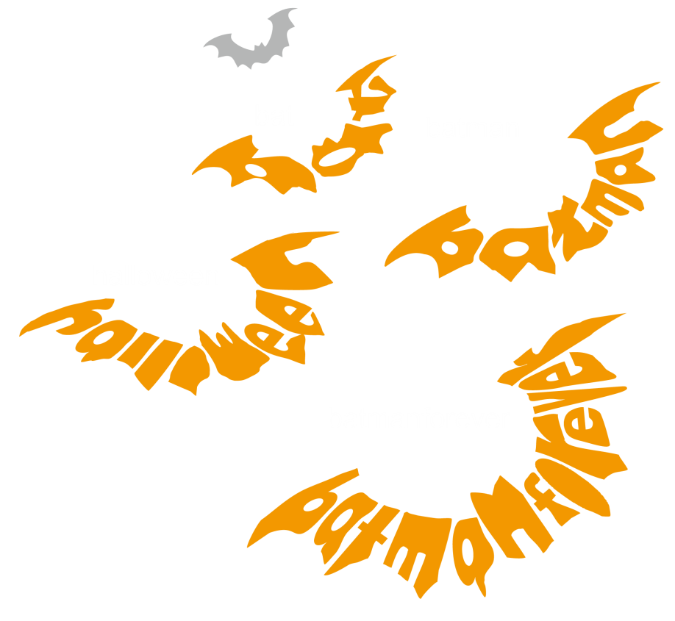
Input variations: same outline image
Notes:
To test the robustness of our method, we also evaluated our method with the same input shape, but words have different length

Slide 36
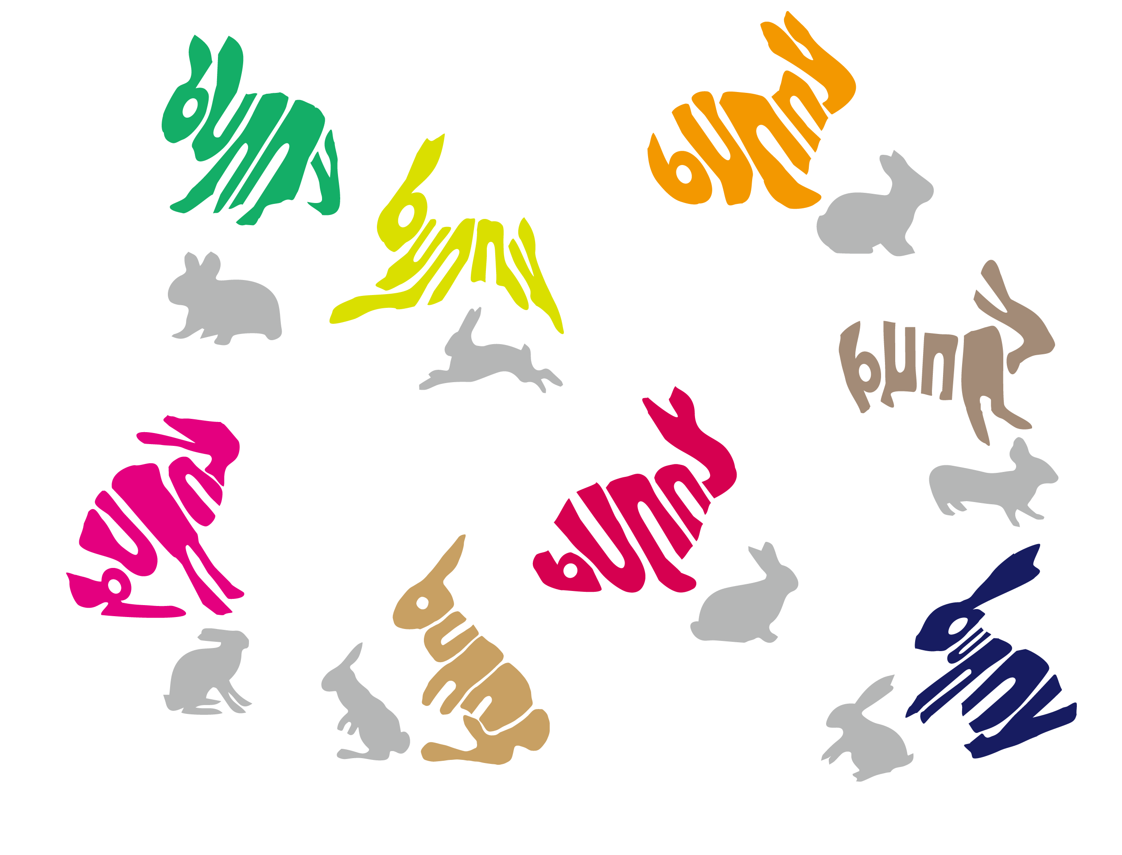
Input variations: same word
Notes:
Here are results for the same word bunny but on various input shapes.

Slide 37
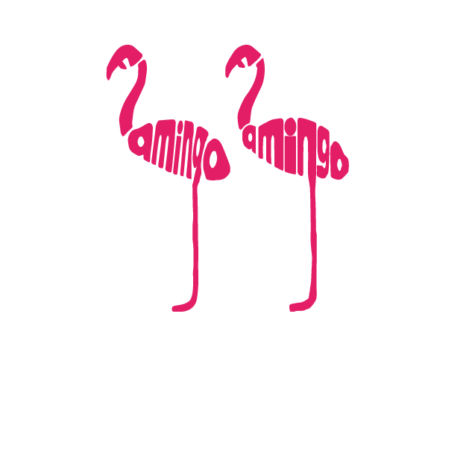
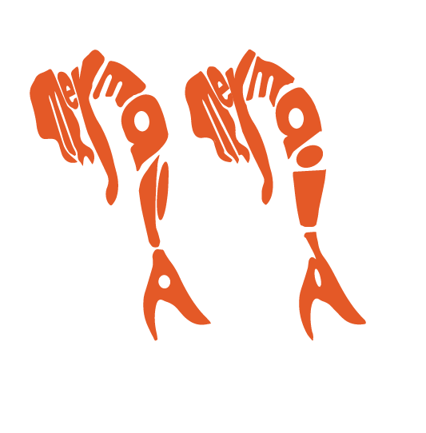
Parameter variations
Protrusion correspondence
Orientation consistence
Results from different parameter settings
Notes:
While all the results shown so far were produced fully automatically, using the same parameters, we can also adjust certain parameters to arrive at different designs. For example, using a different protrusion correspondence for letter alignment, we can obtain two different calligrams where the legs of flamingo are assigned to two different letters; In the right example, increasing the weight for the orientation consistence of letters will make the letter ‘I’ have a quite different orientation with other letters.

Slide 38
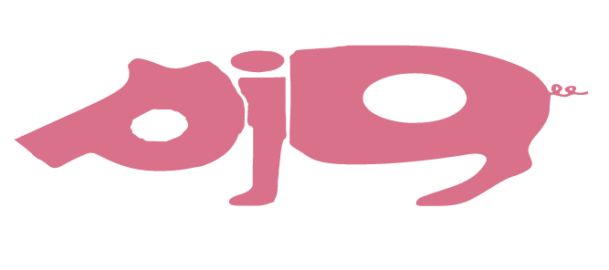
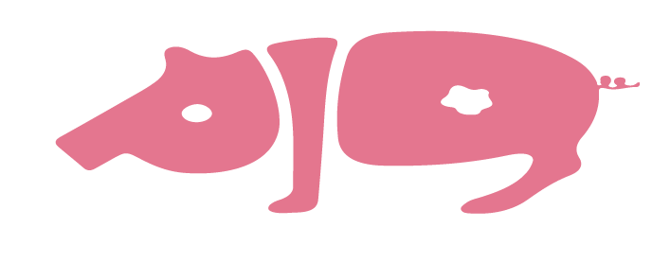
User study: overall quality
Result from our algorithm
Result from artist
2
Equal quality
9 pairs of algorithmic and artist-designed calligrams
30 participants; 270 responses
50.74% favored our method over artist’s designs or indicated that they are of equal quality (9.56%)
Notes:
To evaluate our fully automatically generated calligrams, we conducted several user studies.
In one study, we asked 30 participants to rate word animals generated by our method against those created by the artist Dan Flemming. On all the 9 tested pairs, about 50% of the times, the participants preferred our results or claimed indifference.

Slide 39
Word animals vs. Professional artist
Professional artist
Fully automatic
Notes:
Here are some comparison results.

Slide 40
Word animals vs. Professional artist
Professional artist
Fully automatic
Professional artist
Fully automatic
Notes:
Here are two more …

Slide 41
User study: algorithmic vs. manual
Result from our algorithm
Result from users
Equal legible
9 pairs of calligrams
30 participants; 270 responses
41.44% responses ranked our method ahead of all human creators
Notes:
In another user study, we asked multiple human users, other than professional artists, to manually create compact calligrams and compared their creations to our automatic results. The results are also quite favorable. Over 40% of the cases, our results were preferred over human creations.

Slide 42
User study: algorithmic vs. manual
User 1
User 2
Automatic
User 1
User 2
Automatic
User 1
User 2
Automatic
Notes:
Here are some comparison results. From the above results, we can see our automatic method is powerful on a wide range of input data.

Slide 43
Outline
Pipeline
Methodology detail
Results
Limitation
Conclusion
Notes:
Next, we show the limitations of our method.

Slide 44
Limitations
Notes:
A main technical limitation is our assumption that the layout path is a single low-curvature line. For example, given a outline image and word “penguin”, our method automatically generated this penguin calligram. This penguin calligram may not be as elegant as the artist’s design. With an aid of user-drawn scribble, our method can achieve better results. The snail is another example. The left snail calligram is automatically generated, and the right one is the result generated with aid of user interaction. In future, we hope to look into semi-automatic approaches that achieve a good trade-off.

Slide 45
Limitations
Select/obtain a well-matched input automatically?
Notes:
Another important limitation is that choosing a word-shape combination which can lead to an elegant calligram is not always easy. In the future, it would be ideally for a method to automatically choose a good input shape for a given word, or to allow an input shape to be deformed.

Slide 46
Conclusions
The first fully automatic method for legible, compact calligram generation.
Legibility measure can be potentially useful for other text layout problems.
Notes:
Here, we highlight the main contributions of our method.
We have proposed the first fully automatic method for legible, compact calligram generation.
We have developed a legibility measure algorithm, we believe it can be potentially useful for other text layout problems.

Slide 47
Thanks !
Q&A
Acknowledge:
Mr. Dan Fleming,
SIGGGRAPH reviewers,
user study participates,
NSERC Canada.
Notes:
This concludes my talk. Thank you!

